Slide 1
Air Quality Prediction Using Machine Learning
52. Hrutu Shinde
53. Viraj Shinde
58. Vedant Thorat
62. Yash Yadav

Slide 2
This project aligns with the United Nations Sustainable Development Goals
Sustainable Development Goal (SDG) 3: Good Health and Well-being
SDG 11: Sustainable Cities and Communities

Slide 3
Introduction
- What is Air Quality Index (AQI)?
- Importance of Air Quality Prediction
- How Machine Learning Helps in Forecasting

Slide 4
Problem Statement & Objective
- Problem: Rising pollution impacts health & climate
- Objective: Use ML to predict AQI
- Goal: Provide early warnings

Slide 5
Dataset & Preprocessing
Dataset: Includes pollutant & environmental data
Features: PM2.5, PM10, NO2, CO, SO2, O3
Data Cleaning: Handled missing values & non-numeric data

Slide 6
Model Selection & Training
ML Models Used: Random Forest, Linear Regression, Decision Tree
Best Model: Random Forest (High Accuracy)
Training: Data split (80% train, 20% test)

Slide 7
Results & Visualizations
- Random Forest achieved ~90% accuracy (R² Score)
- Model Evaluation: MSE, RMSE Comparison
- Graph: Actual vs Predicted AQI

Slide 8
Frontend Design & User Interface
Framework Used :
Streamlit(Python-based for creating data apps)
UI Elements :
Sidebar
City dropdown
Sliders for pollutants (PM2.5, PM10, CO, NO₂, O₃)
Predict AQI button
Main Area
Predicted AQI value + color-coded category (e.g., Moderate)
Historical AQI trend (line chart)
AQI geo map (interactive city-wise bubbles)

Slide 9
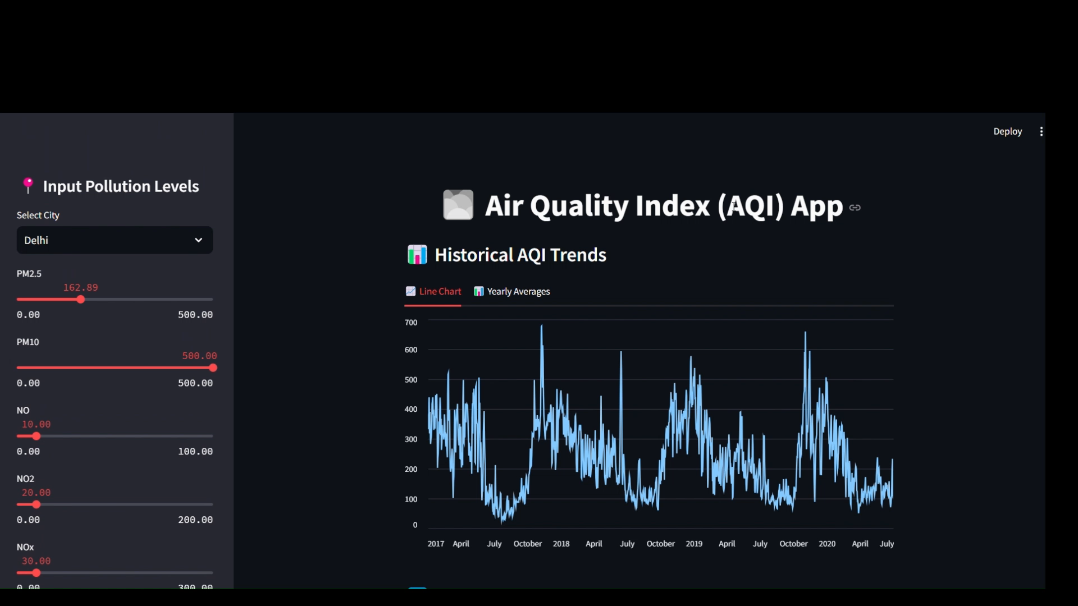
Webpage:

Slide 10
Comparative Analysis: Before vs After AI in AQI Prediction
Before AI:
- Manual monitoring, slower updates, low accuracy
After AI:
- Real-time processing, predictive analytics, automation

Slide 11
Conclusion & Future Scope
- ML helps in early detection of pollution spikes
- Future Scope:
- IoT-based real-time air monitoring
- Deep Learning models for better accuracy
- Mobile app integration

Slide 12

Thank You!

